Slide 1
Dự án Semitheo

Slide 2
Ocaml
- Cài đặt
  sudo apt install ocaml opam
  ocamplopt –v
- Chạy demo từ ví dụ
  touch hello.ml
  touch hello_stubs.c
  ocamlopt –o hello.opt hello.ml hello_stubs.c
  ./hello.opt

Slide 3
Isabelle
- Cài đặt: https://isabelle.in.tum.de/
Chạy demo:
  Tạo file file_name.thy
  theory file_name
  imports Main
  begin
  lemma "False ⟶ ¬ True"
  apply simp
  done
  lemma "False ⟶ ¬ True"
  by simp
  definition nand :: "bool⇒bool⇒bool" (infixr "↑" 35)
  where "A ↑ B ≡ ¬(A ∧ B)"
  lemma "¬ A ⟷ A ↑ A"
  unfolding nand_def by simp
  end

Slide 4
Folderol
Cài đặt
  git clone https://github.com/jubnzv/folderol.git
  cd folderol
  opam init –base –disable-sandboxing
  opam switch create 4.14.1
  eval $(opam env)
  opam install –deps-only .
  opam install sedlex.3.6
  opam install ppx-deriving
  dune build
Chạy demo
  _build/default/src/bin/folderol.exe examples/assoc.txt

Slide 5
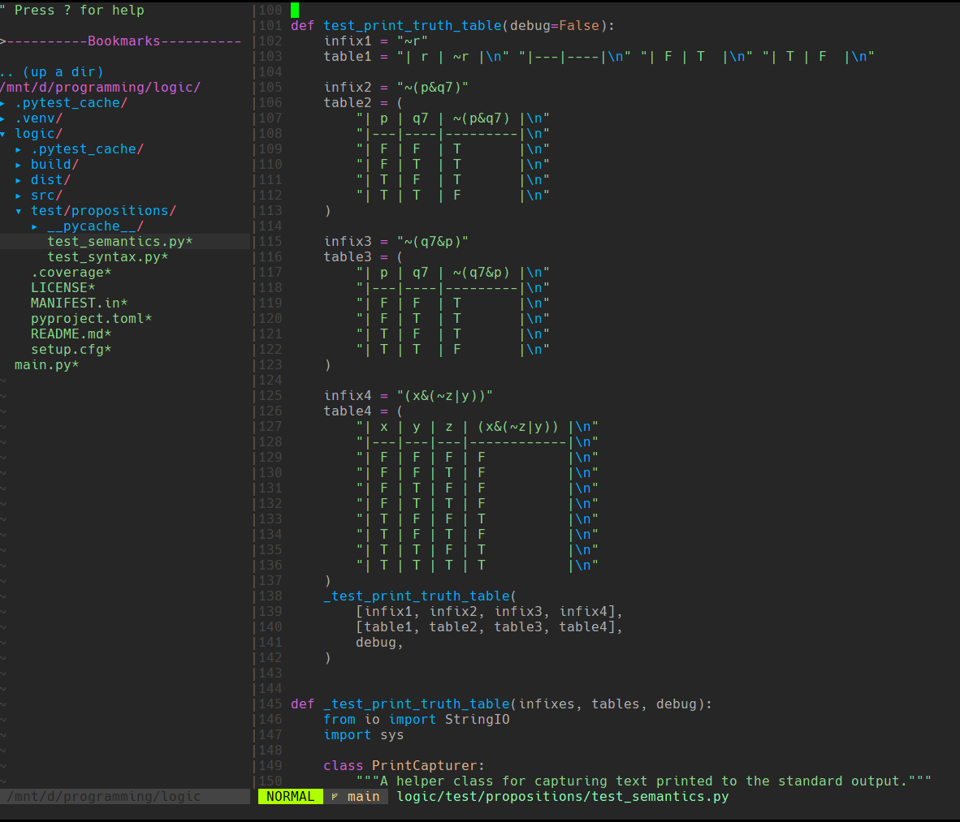
Python
Viết chương trình tương tự như folderol
bằng ngôn ngữ python
Syntax
Semantic

Slide 6
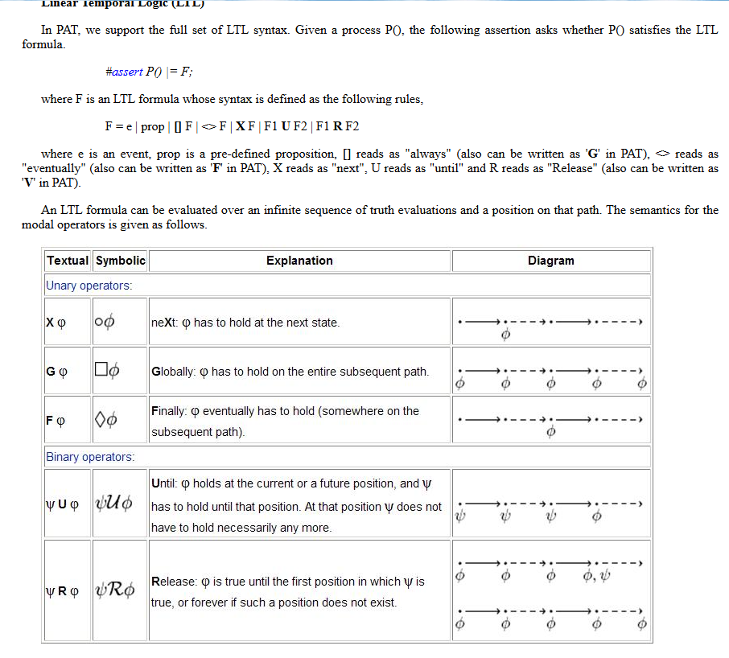
PAT
Cài đặt: link
Từ đó hiểu được model checking
  Unconditional fairness
  G F A
  Strong fairness
  G F A → G F B
  Weak fairness
  F G A → G F B
  Safety
  G ¬A
  Liveness
  F A

Slide 7
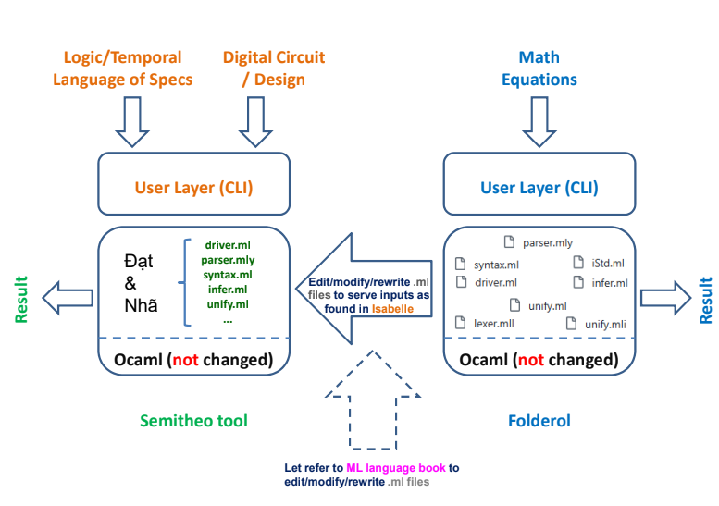

Slide 8
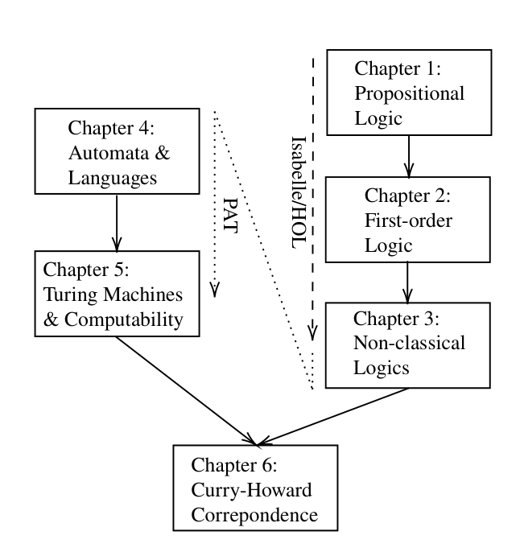
Tài liệu tham khảo
1. Fundamentals of Logic and Computation With Practical Automated Reasoning and Verification

